Slide 1
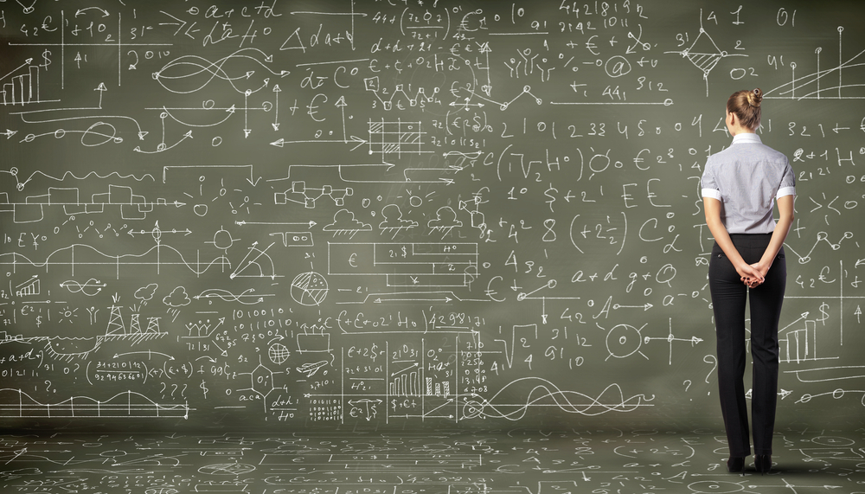
SDN, NFV and Cloud, and Network Automation The Journey from CLI to Machine Intelligence
David Meyer
IEEE Netsoft 2015
CTO & Chief Scientist, Brocade
Research Scientist, University of Oregon
dmm@{brocade.com, 1-4-5.net,uoregon.edu, …}

Slide 2
Agenda
Goals for this Talk
Context and Framing: Automation Continuum
Software Defined Intelligence
What kind of architecture do we need for this?
Briefly: What is Machine Learning?
Mobile Use Case
Summary
Appendix: How can machine learning possibly work?

Slide 3
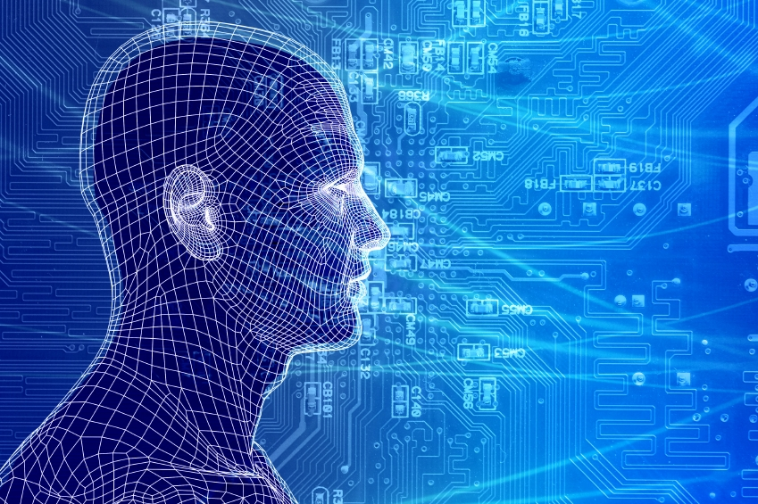
Goals for this Talks
To give us a basic common
understanding of the analytics and
machine learning landscape
so that we can see the (near) future
and discuss current industry
transitions in the network
automation space.
While minimizing the math ☺

Slide 4
Agenda
Goals for this Talk
Context and Framing: Automation Continuum
Software Defined Intelligence
What kind of architecture do we need for this?
Briefly: What is Machine Learning?
Mobile Use Case
Summary
Appendix: How can machine learning possibly work?

Slide 5
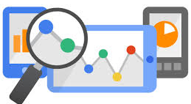
Context and Framing
Lots of excitement around “analytics” and machine learning
But what are “analytics”, and what use cases are
near term (vs longer term)?

Slide 6
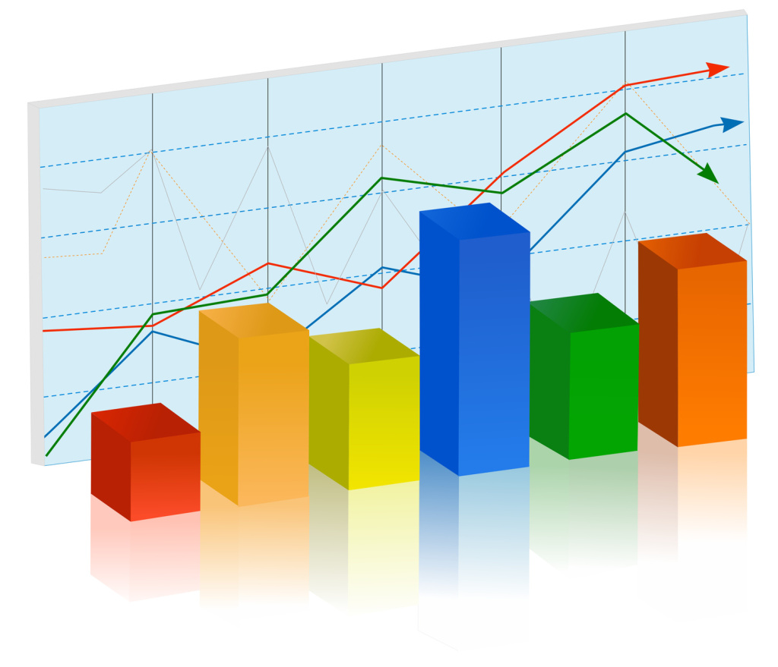
One Way to Segment the Space
Historical Analytics
Build data warehouses / run batch queries to predict future events / generate trend reports
Near Real-Time Analytics
Analyze indexed data to provide visibility into current environment / provide usage reports
Real-Time Analytics (“streaming”)
Analyze data as it is created to provide instantaneous, actionable business intelligence to affect immediate change
Who’s network gear/software streams data?
Predictive Analytics
Build statistical models that can classify/predict the near future
BTW, how can this work from a technical perspective?
Maybe more on this later

Slide 7
Another Way To Think About This
The Automation Continuum
Machine Learning
Average Enterprise
Industry Pioneers
CONTROLLER-BASED ARCHITECTURE
CLI
CLI SCRIPTING
Manual
Automated/Dynamic
CLI
AUTOMATION
Machine
Intelligence
INTEGRATION
PROGRAMMABILITY
DEVOPS / NETOPS
ORCHESTRATION
Original slide courtesy Mike Bushong and Joshua Soto
Notes:
Most customers are at the very early side of this continuum of maturity when it comes to automating the network. They may have a couple of expect scripts, some MOPs and SOPs, but things are not really automated in any really meaningful way. They don’t have any sort of control framework or controller, not using OpenStack, not interested in programmability. Most want the network to be easier to manage.
Companies such as Netflix, are at the furthest end of the spectrum using a much more fully integrated Dev/NetOps approach
Our job is not to paint a picture of our customer’s full operational maturity, our job is to show them that we know what full operational maturity looks like and then get them further down the continuum in that direction.
Present in the industry today is a huge separation between where customers are today and the “vision” that everyone is talking about.
Your role as a sales person, is to be the TRUSTED ADVISOR that doesn’t judge the customer for where they are, but can identify their current pain point and point to a path to full operational maturity over the next several years.
Mike’s analogy for a 22hr treadmill session

Slide 8
What Types of Network Centric Data are Out There?
Profile
Profiling
Identity (Persistent)
Demographics
Explicit profile (interests, etc.)
Device(s) and capabilities
Billing / Subscription plan
Device sensor data
Persistent Location / Presence
Behavioral / Search / Social
Purchasing / Payments
Mobility patterns
Usage data (from device)
User
Analytics
Content
Analytics
Catalog / Title
Topic / Keywords
CA / Rights management
Encryption / DRM
Format(s) / Aspect ratio(s)
Resolution(s) / Frame rate(s)
Consumption data
Content reach
Asset popularity / revenue
Distribution/Retention/Archival
Search / Discover / Recommend
Usage Data (from content source)
Network
Analytics
Bandwidth and latency
Access types
IP pools
Routes / topology / Path
QoS / Policy Rulesets
Network Service Capabilities
Active subscriber demographics
Crowdsourced data
Geographic segmentation
Network Performance / Quality
Network sensor data (IoT/M2M)
Usage (from DPI)
Slide courtesy Kevin Shatzkamer

Slide 9





What Might a (Mobile) Analytics Platform Look Like?
Think “Platform”, not Applications, Algorithm, Visualization
3rd Party Applications
Service Provider Use-Cases
SON
PCRF
SDN
Controller
NFV-O
Index / Schema
(Metadata Mgmt)
Operations
Marketing
Cust. Care
NW Planning
Security
Distributed Data Management
(Pre-filtering, aggregation, normalization (time / location), distribution)
Data Management
(Correlation, trend analysis, pattern recognition)
Data Collection (Push) / Extraction (Pull)
(RAN, IPBH, LTE EPC, Gi LAN, IMS, Network Services, OSS)
Direct API
Tap / SPAN
PCRF
IMS
SDN Svc Chain
eNB
vEPC
DPI
NAT
CSR
Aggregation
Router
IP Edge
Internet
RAN
Video Opt.
App Proxy
Gi LAN Services
Slide courtesy Kevin Shatzkamer

Slide 10
Agenda
Goals for this Talk
Context and Framing: Automation Continuum
Software Defined Intelligence
What kind of architecture do we need for this?
Briefly: What is Machine Learning?
Mobile Use Case
Summary
Appendix: How can machine learning possibly work?

Slide 11
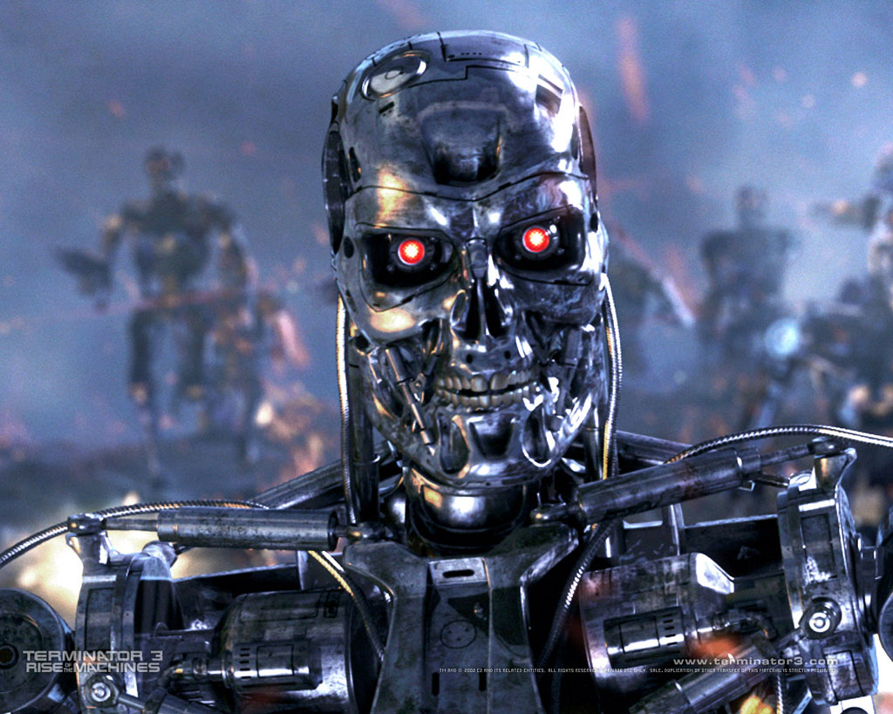
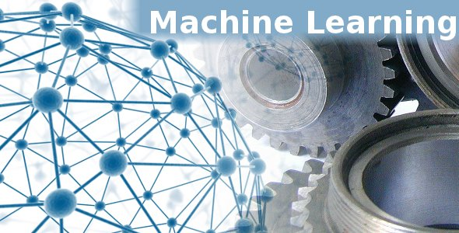
Where I Want To Go With This
Artificial General Intelligence
http://en.wikipedia.org/wiki/Artificial_general_intelligence
Not This
“Narrow AI”
What Might an Architecture for this Look Like?

Slide 12



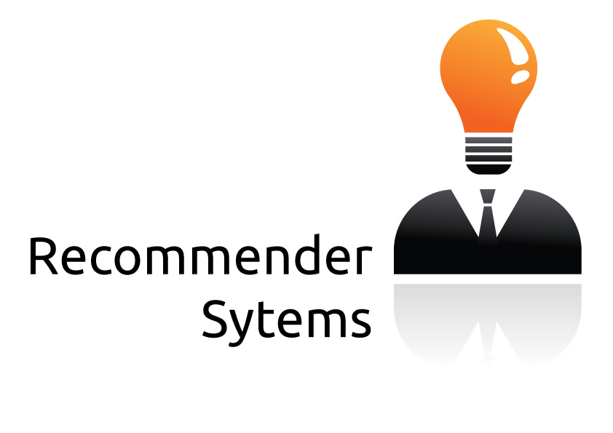



Software Defined Intelligence
Architecture Strawman
Domain Knowledge
Domain Knowledge
Domain Knowledge
Domain Knowledge
3rd party Applications
Analytics Platform
Learning
Presentation Layer
Intelligence
Data Collection
Packet brokers, flow data, …
Preprocessing
Big Data, Hadoop, Data Science, …
Model Generation
Machine Learning
Oracle
Model(s)
Remediation/Optimization/…
Oracle
Logic
Topology, Anomaly Detection,
Root Cause Analysis,
Predictive Insight, ….

Slide 13
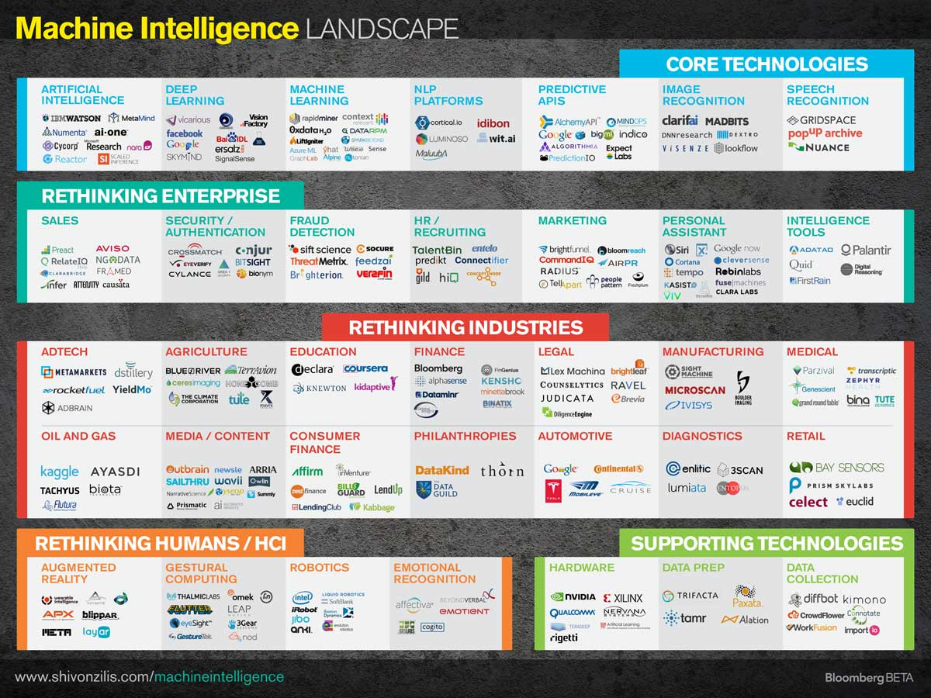

Slide 14
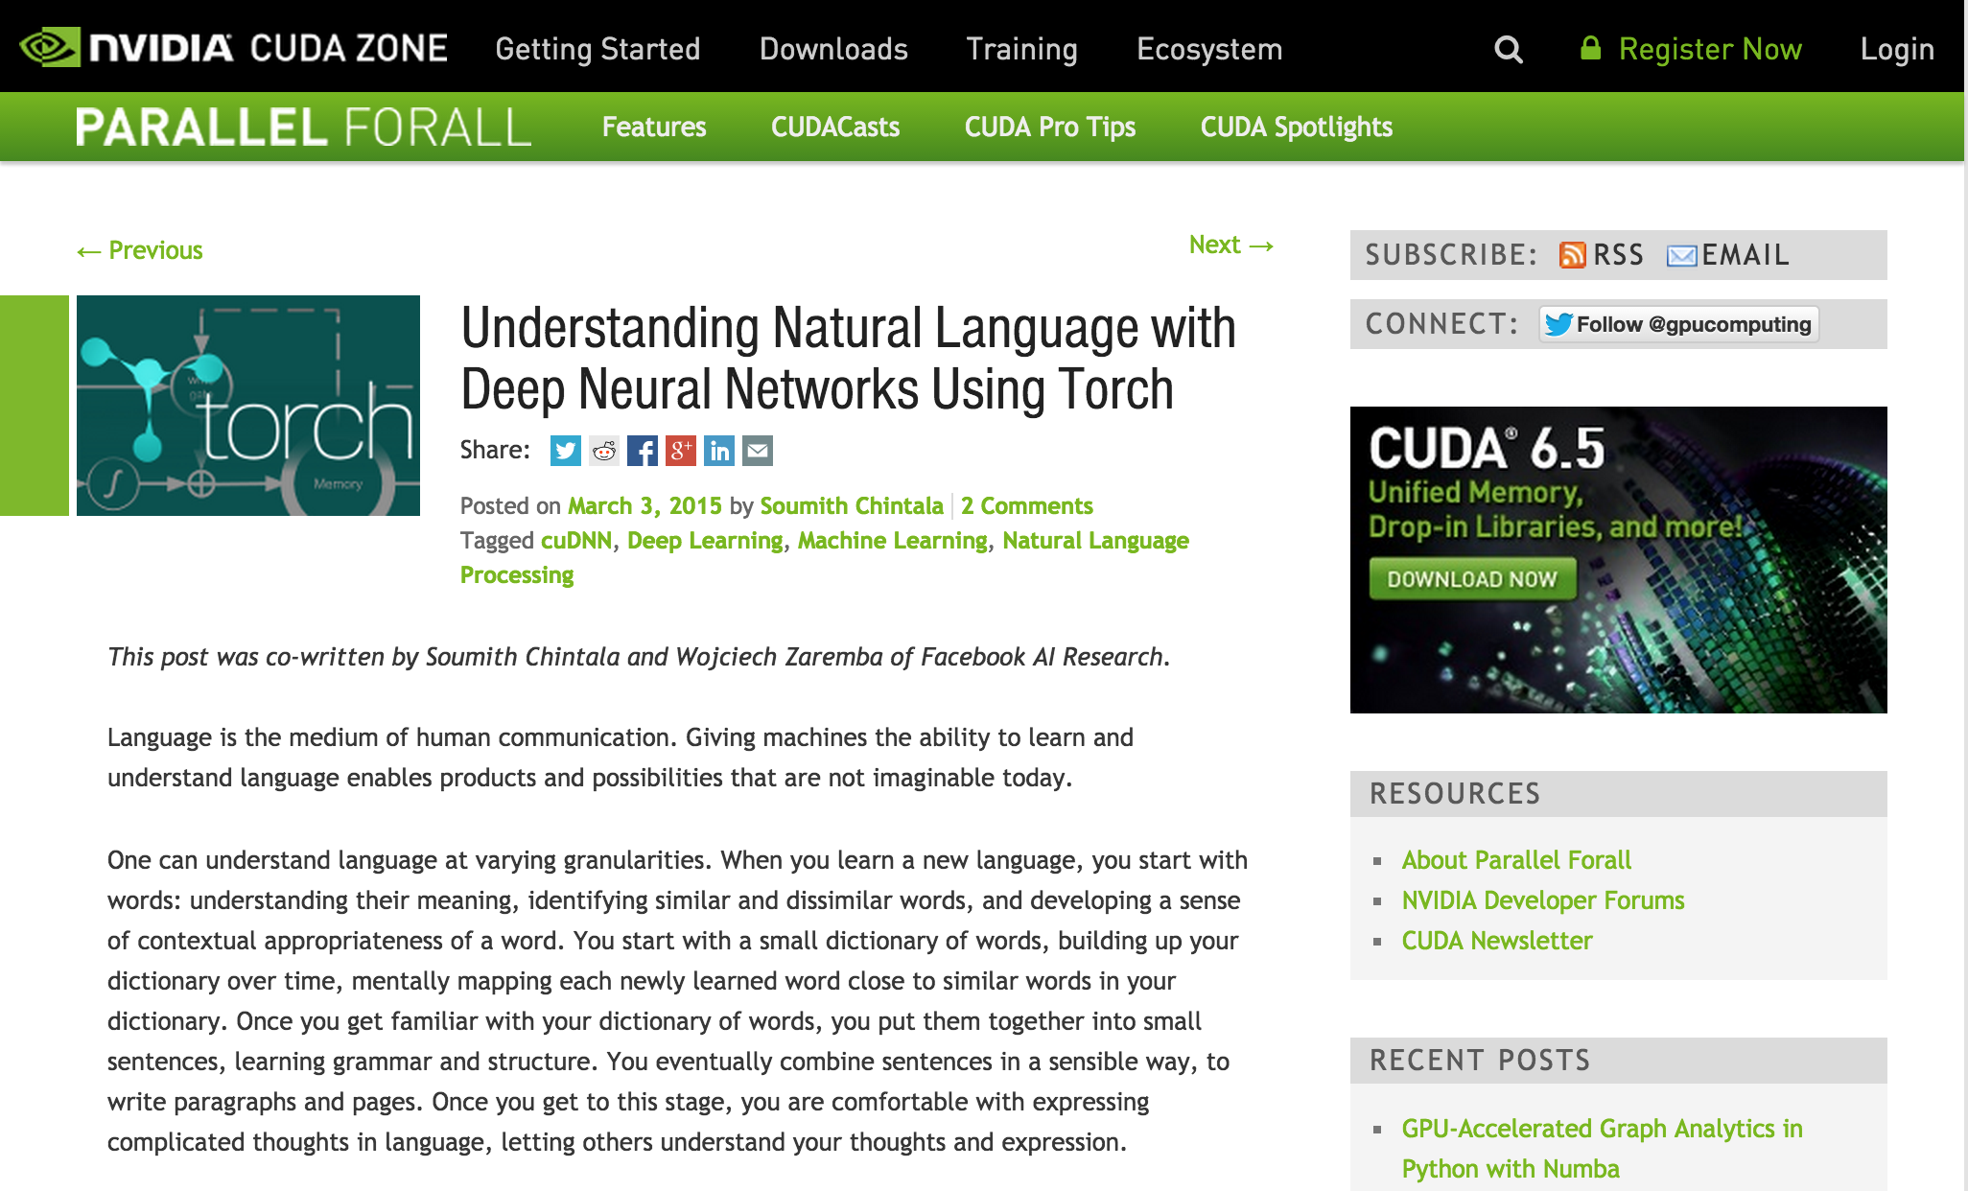
Aside: NVIDA

Slide 15
Agenda
Goals for this Talk
Context and Framing: Automation Continuum
Software Defined Intelligence
What kind of architecture do we need for this?
Briefly: What is Machine Learning?
Mobile Use Case
Summary
Appendix: How can machine learning possibly work?

Slide 16
Goals for this Section
To cut through some of the Machine
Learning (ML) hype and give us a
basic common understanding of ML
so that we can discuss its application
to our use cases of interest.
So, remembering our strawman architecture…

Slide 17
Strawman Architecture
Domain Knowledge
Domain Knowledge
Domain Knowledge
Domain Knowledge
3rd party Applications
Focus Here
Presentation Layer
Data Collection
Packet brokers, flow data, …
Preprocessing
Big Data, Hadoop, Data Science, …
Model Generation
Machine Learning
Oracle
Model(s)
Remediation/Optimization/…
Oracle
Logic

Slide 18
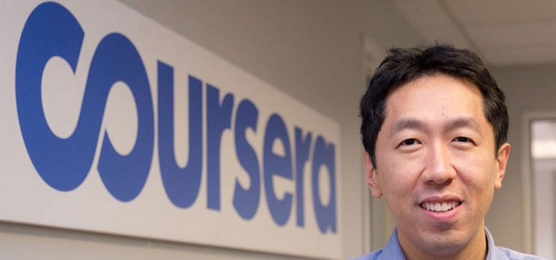
Before We Start What is the SOTA in Machine Learning?
“Building High-level Features Using Large Scale Unsupervised Learning”, Andrew Ng, et. al, 2012
http://arxiv.org/pdf/1112.6209.pdf
Training a deep neural network
Showed that it is possible to train neurons to be selective for high-level concepts using entirely unlabeled data
In particular, they trained a deep neural network that functions as detectors for faces, human bodies, and cat faces by training on random frames of YouTube videos (ImageNet¹). These neurons naturally capture complex invariances such as out-of-plane rotation, scale invariance, …
Details of the Model
Sparse deep auto-encoder (catch me later if you are interested what this is/how it works)
O(10⁹) connections
O(10⁷) 200x200 pixel images, 10³ machines, 16K cores
→ Input data in R⁴⁰⁰⁰⁰
Three days to train
15.8% accuracy categorizing 22K object classes
70% improvement over current results
Random guess achieves less than 0.005% accuracy for this dataset
Even newer: Google’s FaceNet results
http://arxiv.org/pdf/1503.03832.pdf
New record accuracy (99.63%) on the Labeled Faces in the Wild (LFW) data set, 95.12% on the Youtube Faces data set
Andrew Ng and his crew at Baidu have recently beat this record with their
(GPU based) Deep Speech system. See http://arxiv.org/abs/1412.5567
1 http://www.image-net.org/

Slide 19
What is Machine Learning?
The complexity in traditional computer programming is in the code (programs that people write). In machine learning, algorithms (programs) are in principle simple and the complexity (structure) is in the data. Is there a way that we can automatically learn that structure? That is what is at the heart of machine learning.
-- Andrew Ng
That is, machine learning is the about the construction and study
of systems that can learn from data. This is very different than
traditional computer programming.

Slide 20
The Same Thing Said in Cartoon Form
Traditional Programming
Machine Learning
Data
Computer
Output
Program
Data
Computer
Program
Output

Slide 21
When Would We Use Machine Learning?
When patterns exists in our data
Even if we don’t know what they are
Or perhaps especially when we don’t know what they are
We can not pin down the functional relationships mathematically
Else we would just code up the algorithm
When we have lots of (unlabeled) data
Labeled training sets harder to come by
Data is of high-dimension
High dimension “features”
For example, network telemetry and/or sensor data
Want to “discover” lower-dimension representations
Dimension reduction
Aside: Machine Learning is heavily focused on implementability
Frequently using well know numerical optimization techniques
Lots of open source code available
See e.g., libsvm (Support Vector Machines): http://www.csie.ntu.edu.tw/~cjlin/libsvm/
Most of my code in python: http://scikit-learn.org/stable/ (many others)
Languages (e.g., octave: https://www.gnu.org/software/octave/)
Newer: Torch: http://torch.ch/ (lua)

Slide 22
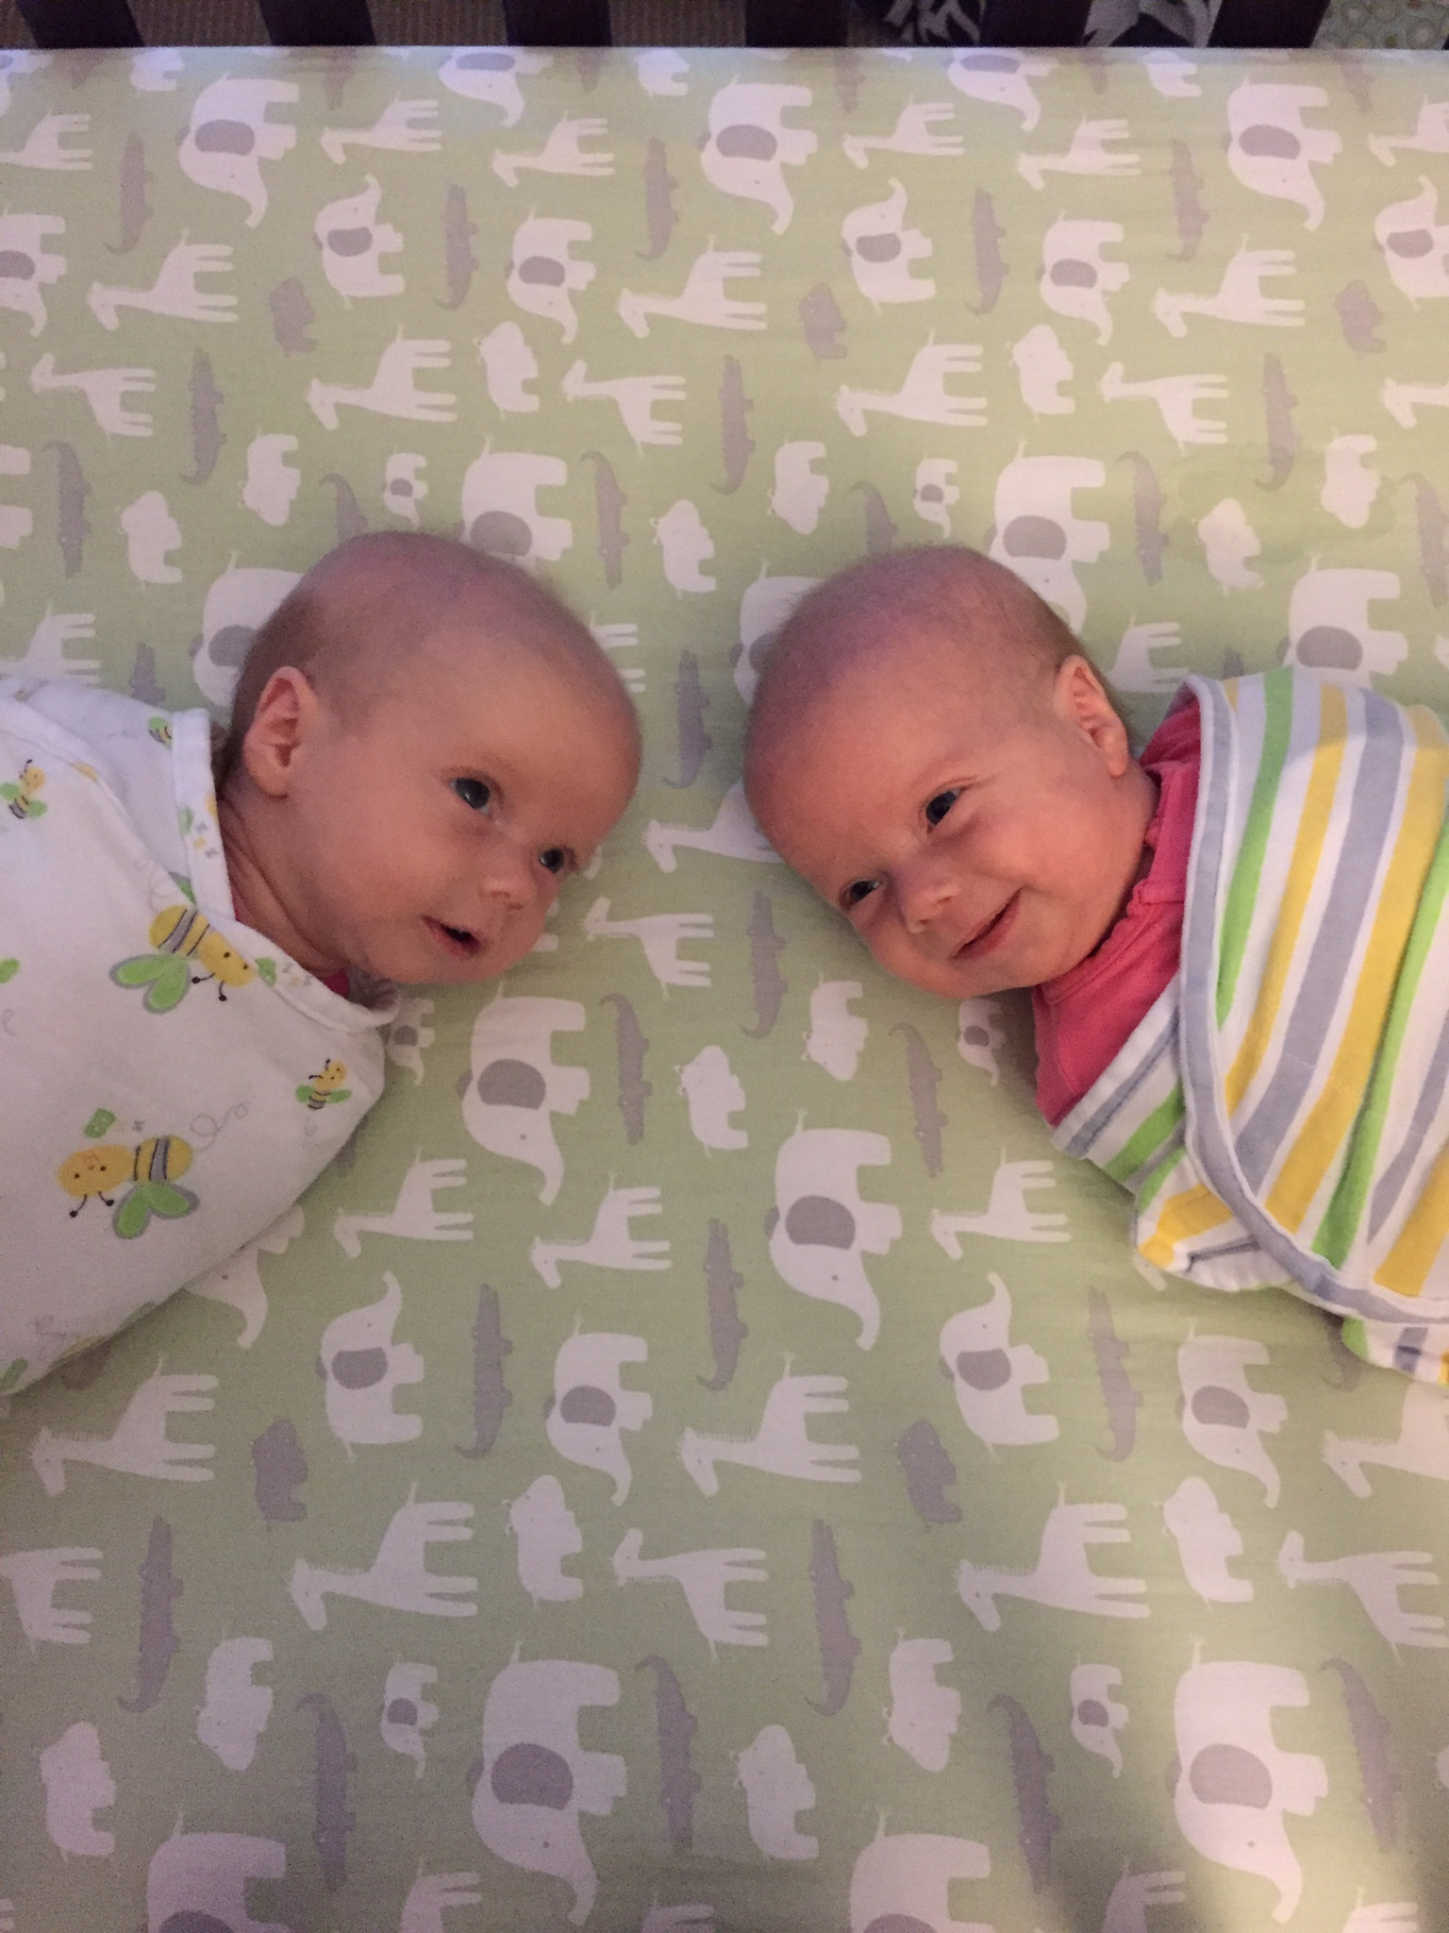
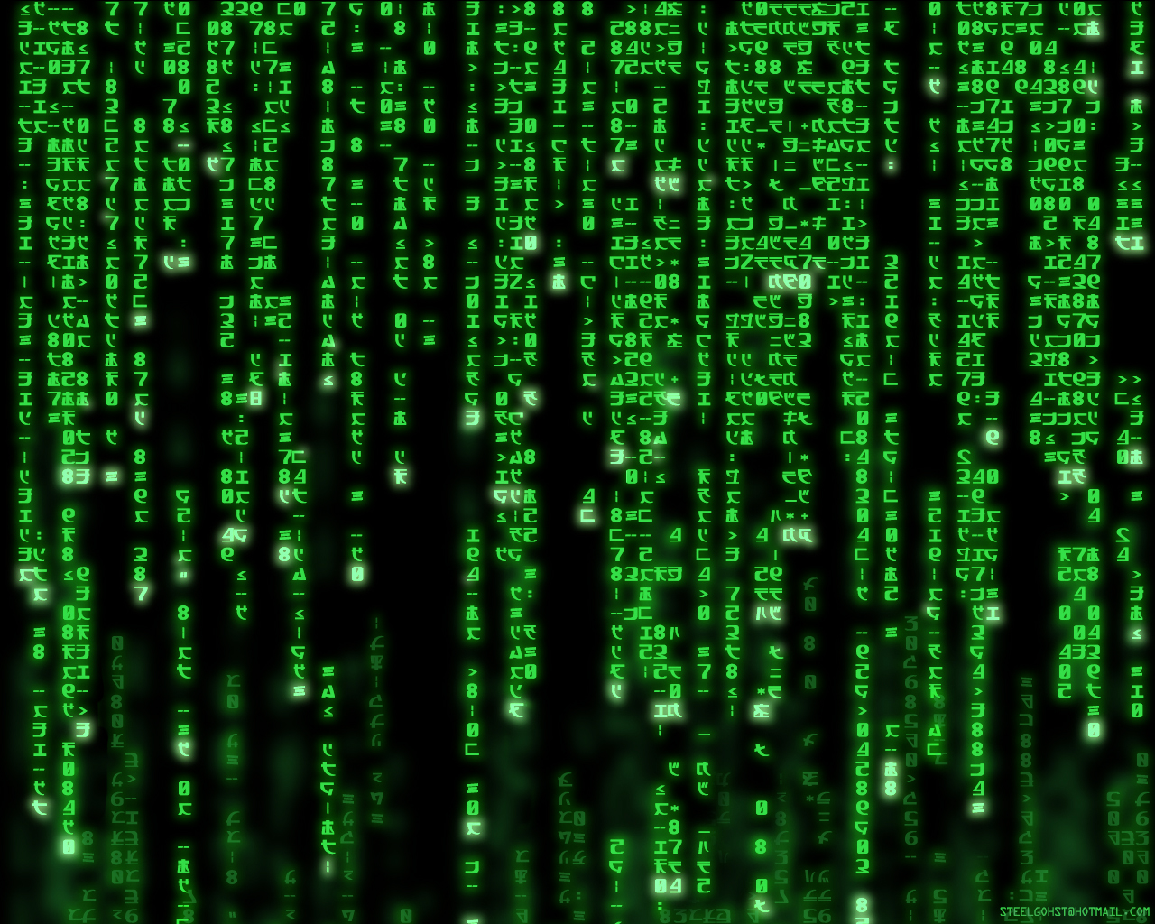
Why Machine Learning is Hard?
Your ML Algorithm Sees
A Bunch of Bits
You See

Slide 23
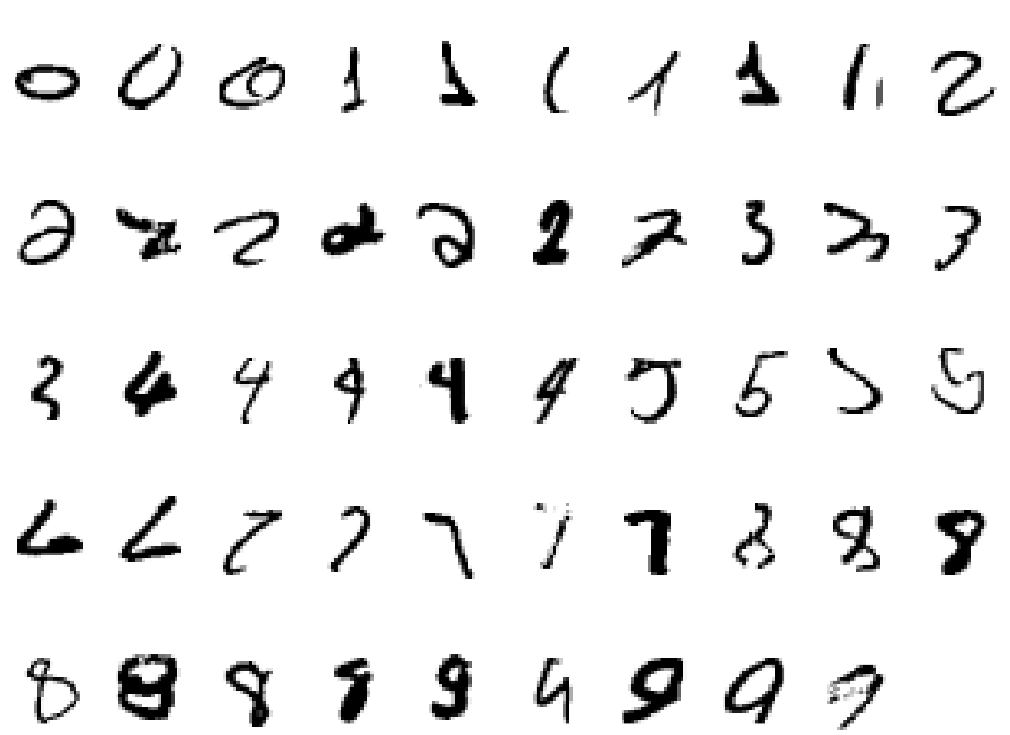
Why Machine Learning Is Hard, Redux What is a “2”?

Slide 24
Examples of Machine Learning Problems
Pattern Recognition
Facial identities or facial expressions
Handwritten or spoken words (e.g., Siri)
Medical images
Sensor Data/IoT
Optimization
Many parameters have “hidden” relationships that can be the basis of optimization
Pattern Generation
Generating images or motion sequences
Anomaly Detection
Unusual patterns in the telemetry from physical and/or virtual plants (e.g., data centers)
Unusual sequences of credit card transactions
Unusual patterns of sensor data from a nuclear power plant
or unusual sound in your car engine or …
Prediction
Future stock prices or currency exchange rates
Network events/hardware failures, …
…

Slide 25
Ok, But What Exactly Is Machine Learning?
Machine Learning is a procedure that consists of estimating the model parameters so that the learned model (algorithm) can perform a specific task
Typically try estimate model parameters such that prediction error is minimized
2 types of learning considered here
Supervised
Unsupervised
Semi-supervised learning
Reinforcement learning
Supervised learning
Present the algorithm with a set of inputs and their corresponding outputs
Essentially have a “teacher” that tells you what each training example is
See how closely the actual outputs match the desired ones
Note generalization error (bias, variance)
Iteratively modify the parameters to better approximate the desired outputs (gradient descent)
Unsupervised
Algorithm learns internal representations and important features
So let’s take a closer look at these learning types

Slide 26
Supervised learning
You are given training data and “what each item is”
e.g., a set of images and corresponding descriptions (labels)
“this is a cat” or “this is a chair” (cat or chair is a label)
Training set consists of (x^{(i)},y^{(i)}) pairs, x^{(i)} is the input example, y^{(i)} is the label
You want to find f(x^{(i)}) = y^{(i)}, but you don’t know f
Another way to look at the training set: (x^{(i)},y^{(i)}) = (x^{(i)}, f(x^{(i)}))
Goal: accurately {predict,classify,compute} the label for previous unseen x
Learning comes down to finding a parameter set for your model that minimizes prediction error → learning is an optimization problem
There are many 10s (if not 10^2s or 10^3s) of supervised learning algorithms
These include: Artificial Neural Networks, Decision Trees, Ensembles (Bagging, Boosting, Random Forests, …), k-NN, Linear Regression, Naive Bayes, Logistic Regression (and other CRFs), Support Vector Machines (and other Large Margin Classifiers), …

Slide 27
Unsupervised learning
Basic idea: Discover unknown compositional structure in input data
Data clustering and dimension reduction
More generally: find the relationships/structure in the data set
No need for labeled data
The network itself finds the correlations in the data
Learning algorithms include (again, many algorithms)
K-Means Clustering
Auto-encoders/deep neural networks
Restricted Boltzmann Machines
Hopfield Networks
Sparse Encoders
…

Slide 28
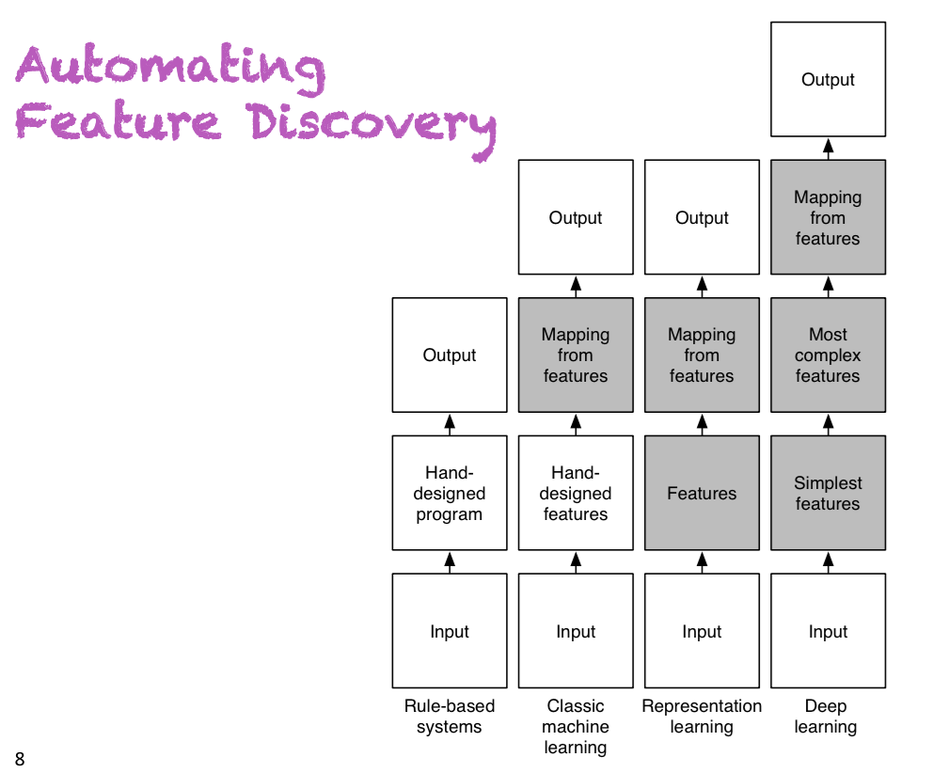
Taxonomy of Learning Techniques
Where the
excitement
is happening
Slide courtesy Yoshua Bengio

Slide 29
Artificial Neural Networks
A Bit of History
Biological Inspiration
Artificial Neurons (AN)
Artificial Neural Networks (ANN)
Computational Power of Single AN
Computational Power of an ANN
Training an ANN -- Learning

Slide 30
Brief History of Neural Networks
1943: McCulloch & Pitts show that neurons can be combined to construct a Turing machine (using ANDs, ORs, & NOTs)
1958: Rosenblatt shows that perceptrons will converge if what they are trying to learn can be represented
1969: Minsky & Papert showed the limitations of perceptrons, killing research for a decade
1985: The backpropagation algorithm revitalizes the field
Geoff Hinton et al
2006: The Hinton lab solves the training problem for DNNs

Slide 31
Biological Inspiration: Neurons (but be careful…)
A neuron has
Branching input (dendrites)
Branching output (the axon)
Information moves from the dendrites to the axon via the cell body
Axon connects to dendrites via synapses
Synapses vary in strength
Synapses may be excitatory or inhibitory

Slide 32
What is an Artificial Neuron? (easy math ☺)
An Artificial Neuron (AN) is a non-linear parameterized function with restricted output range
bias term
y
b
w₁
w₂
w₃
x1
x2
x3
tiny non-linearity
(activation function)
linear combination

Slide 33
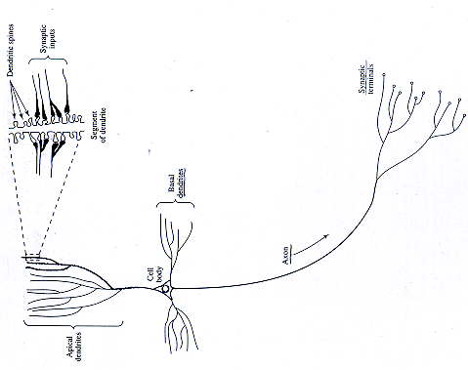
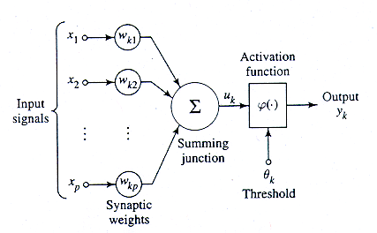
Mapping to Biological Neurons
Dendrite
Cell Body
Axon

Slide 34
Ok, Then What is an Artificial Neural Network (ANN)?
An ANN is mathematical model designed to solve engineering problems
Group of highly connected artificial neurons to realize compositions of non-linear functions (usually one of the ones we just looked at)
Tasks
Classification
Discrimination
Estimation
2 main types of networks
Feed forward Neural Networks
Recurrent Neural Networks

Slide 35
Feed Forward Neural Networks
The information is propagated from the inputs to the outputs
Directed Acyclic Graph (DAG)
Computes one or more non-linear functions
Computation is carried out by composition of some number of algebraic functions implemented by the connections, weights and biases of the hidden and output layers
Hidden layers compute intermediate representations
Dimension reduction
Time has no role -- no cycles between outputs and inputs
However, in some models each hidden layer models one time step
Output layer
2nd hidden
layer
1st hidden
layer
x₁
x₂
…..
x_{n}
We say that the input data, or features, are n dimensional

Slide 36
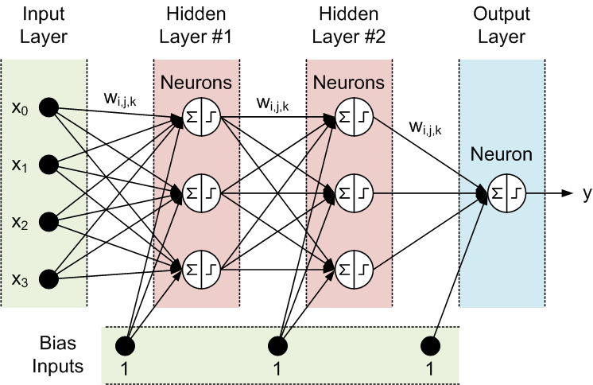
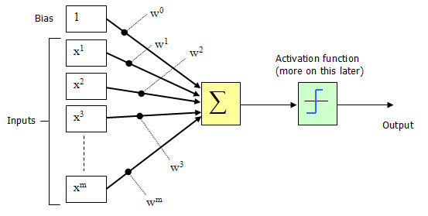
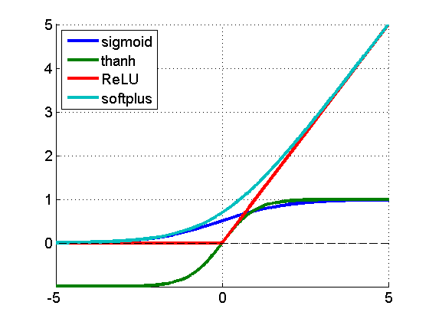
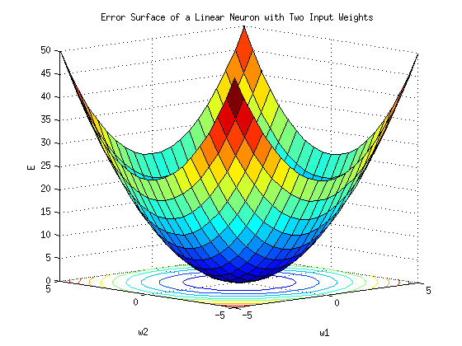
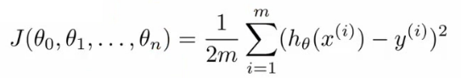
Deep Feed Forward Neural Nets (all the math I’m going to give you is on this slide ☺)
(x^{(i)},y^{(i)})
h_{θ}(x^{(i)})
Where do the weights come from?
Hypothesis
f(x^{(i)})
Forward Propagation
So what then is learning?
Learning is the adjusting of the weights w_{i,j} such that
the cost function J(θ) is minimized
Simple learning procedure: Back Propagation (of the error signal)

Slide 37
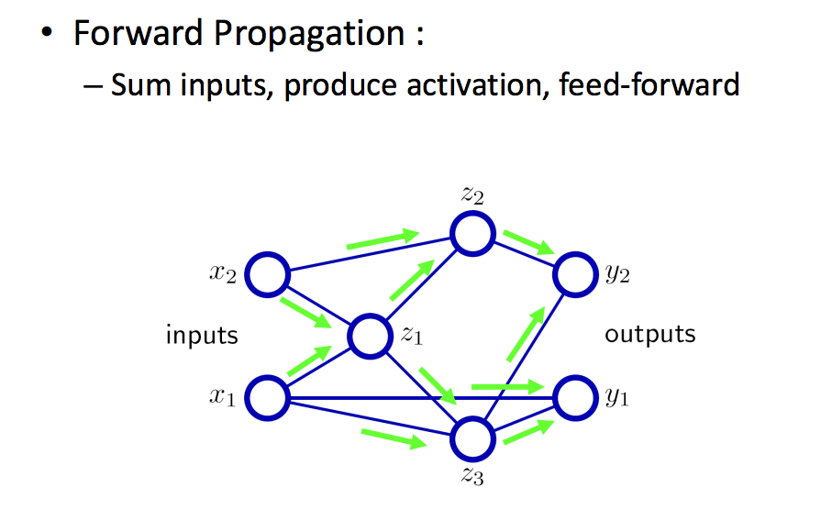
Forward Propagation Cartoon

Slide 38
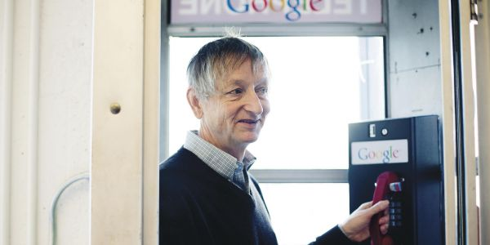
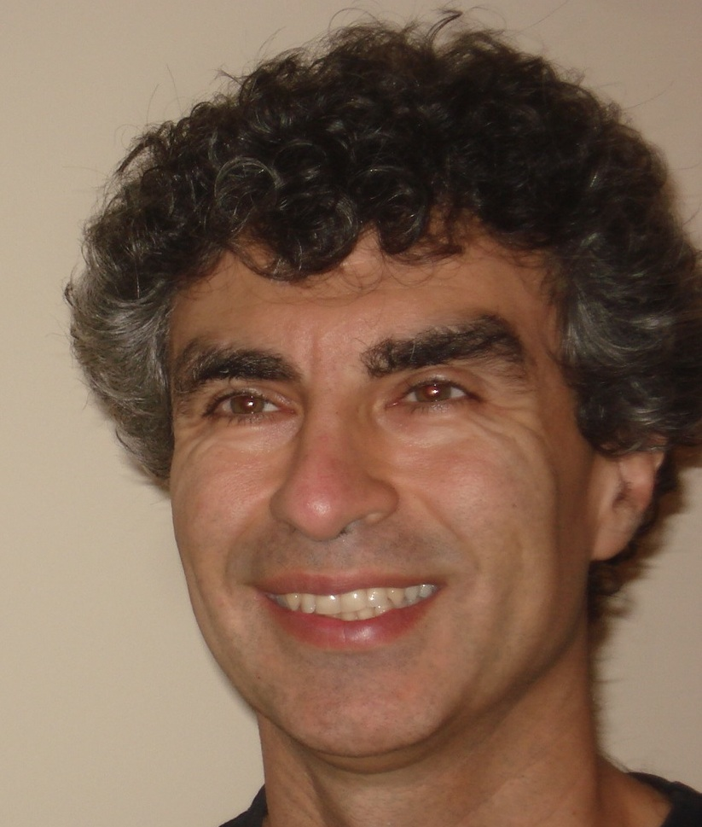
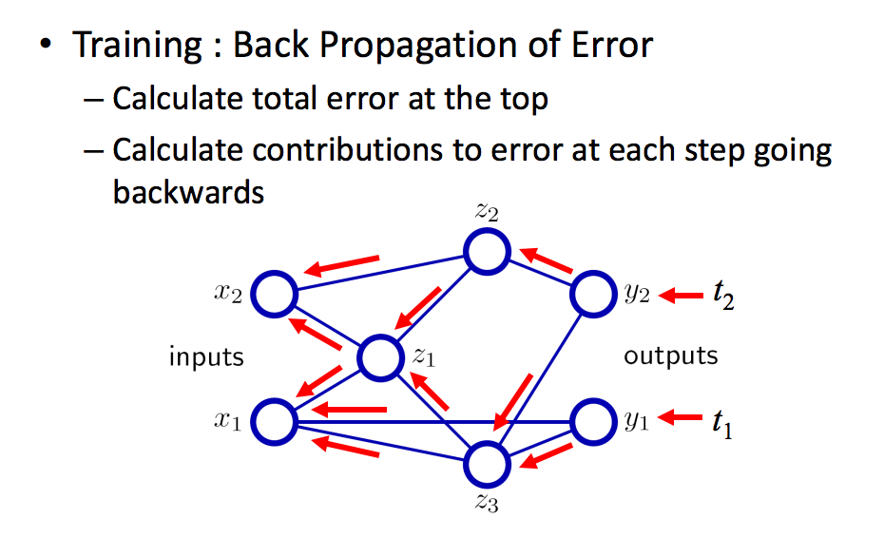

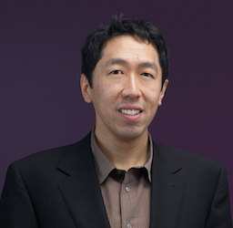
Back propagation Cartoon
http://chronicle.com/article/The-Believers/190147

Slide 39
Agenda
Goals for this Talk
Context and Framing: Automation Continuum
Software Defined Intelligence
What kind of architecture do we need for this?
Briefly: What is Machine Learning?
Mobile Use Case
Summary
Appendix: How can machine learning possibly work?

Slide 40
Now, How About Mobile Use Cases?
Mobile ideally suited to SDN, NFV and Machine Learning
More generally, {SDN,NFV,Cloud} ideally suited to ML
Can we infer properties of paths/equipment/users we can’t directly see?
Likely living in high-dimensional space(es)
i.e., those in other domains
Other inference tasks?
Aggregate bandwidth consumption
Most loaded links/congestion
Cumulative cost of path set
Uncover unseen correlations that allow for new optimizations
And of course, anomaly detection (applies to almost every use case)
How to get there from here
Applying Machine Learning to the Mobile space requires understanding the problem you want to solve and what data sets you have

Slide 41
(Near) Future Mobile Architecture
NFV-O
Analytics
MME
SGW-C
PGW-C
HSS
OFCS
OCS
PCRF
DPI
NAT
Video
Opt.
3rd
Party
SON
IMS
Subscriber Information Base (Shared Session State Database)
SDN Controller
eNB
S1-MME
SGi
IPv6
Internet
RAN
S1-U
SGi
CSR
Control Functions Integrated into NFV, Bearer Functions Integrated into SDN
Enhanced NB and SB APIs in SDN Controller
SGW-C and PGW-C maintain 3GPP-compliant external interfaces (S1-U, S5, S11, SGi, S7/Gx, Gy, Gz)
Integrated Security (Firewall, NAT), removal of physical boundary constraints
Session State Convergence: Subscriber Management delivered via shared columnar/hybrid database
Integrated SON + SDN + NFV-O for Radio + Network + Datacenter policy convergence
Open APIs (Database, Controller, Orchestrator) for 3rd Party Applications
Slide courtesy Kevin Shatzkamer

Slide 42
A Few Data Principles for Future Mobile Architectures
Elastic (for the variance)
Access: Baseband Processing (Cloud RAN), RAN Controllers (Cloud Controllers) Core: Evolved Packet Core, Video Optimization, Deep Packet Inspection, NAT, Firewall, VPN Services: VoLTE/IMS, Video, CDN, Policy, Identity SDP: APIs, M2M Hardware-independence + Virtualization + VM Mobility
Scalable (for the aggregate)
Highly distributed bearer plane Independent control plane (inline or centralized) Policy + Orchestration = Subscriber + Resource Optimization
Dynamic (Evolving to Self-Organizing)
Use analytics models unpredictability in Aggregates and Variances Dynamic decisions (manual or automatic intervention) based on analytics Adaptable routing/forwarding decisions that follow mobility events (subscribers, content, identity, services, applications, virtual machines)
Cost-Effective (OPEX and CAPEX)

Slide 43
What would a Mobile Data Set for Machine Learning look like?
Assume we have labeled data set
{(X⁽¹⁾,Y⁽¹⁾),…,(X^{(n)},Y^{(n)})}
Where X^{(i)} is an m-dimensional vector, and
Y^{(i)} is usually a k dimensional vector, k < m
Strawman X (the network has this information, and much much more)
X^{(i)} = (Path end points,
Desired path constraints,
Signal impairment,
Computed path,
Aggregate path constraints (e.g. path cost),
Minimum cost path,
Minimum load path,
Maximum residual bandwidth path,
Aggregate bandwidth consumption,
Load of the most loaded link,
Cumulative cost of a set of paths,
(some measure of buffer occupancy),
…,
Other (possibly exogenous) data)
If we have Y^{(i)}’s are a set of classes we want to predict, e.g., congestion, latency, …

Slide 44
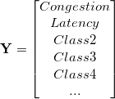
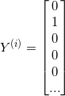
What Might the Labels Look Like? (sparseness)
→
(instance)

Slide 45
Issues/Challenges
Is there a unique model that we can learn?
Concept Drift
→ averaging models over training sets and over time
Unlabeled vs. Labeled Data
Most commercial successes in ML have come with deep supervised learning
We don’t have ready access to large labeled data sets (always a problem)
Training vs. {prediction,classification} Complexity
Stochastic (online) vs. Batch vs. Mini-batch
Where are the computational bottlenecks, and how do those interact with (quasi) real time requirements?
Technical Skills
ML today is a technical (mathematical) discipline

Slide 46
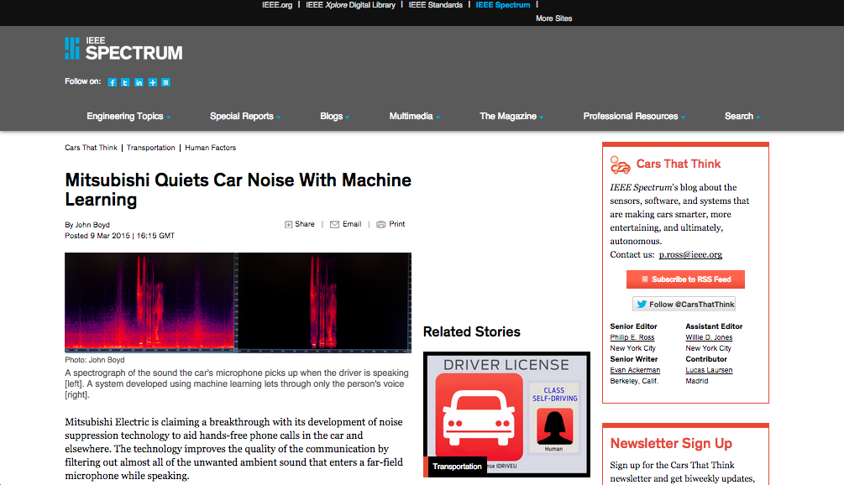
Finally, in the event that you think Machine Learning is Science Fiction…

Slide 47
Agenda
Goals for this Talk
Context and Framing: Automation Continuum
Software Defined Intelligence
What kind of architecture do we need for this?
Briefly: What is Machine Learning?
Mobile Use Case
Summary
Appendix: How can machine learning possibly work?

Slide 48
Summary
ML is real now, chiefly because of
the availability of large data sets
increased compute/storage capability
theoretical breakthroughs in deep learning
Networking is an ideal ML use case
Large and diverse data sets, deep structure
We will see dramatic changes in the way networks are built and operated starting this year as a direct consequence of the incorporation of Machine Learning technologies into network design, engineering and operation tasks
As networking professionals, we need to prepare
{SDN,NFV,Cloud} is a sea-change in how we think about infrastructure
Disaggregation
ML is a sea-change in the way we think think about design, control, operation, and management of that infrastructure
Remember the optimization/remediation/ loop in our architecture

Slide 49
Q&A
Thanks!

Slide 50
How Can Machine Learning Possibly Work?
We want to build statistical models that generalize to unseen cases
What assumptions do we need to do this (essentially predict the future)?
4 main “prior” assumptions are (at least) required
Smoothness
Manifold Hypothesis
Distributed Representation/Compositionality
Compositionality is useful to describe the world around us efficiently → distributed representations (features) are meaningful by themselves.
Non-distributed → # of distinguishable regions linear in # of parameters
Distributed → # of distinguishable regions grows almost exponentially in # of parameters
Each parameter influences many regions, not just local neighbors
Want to generalize non-locally to never-seen regions → essentially exponential gain
Shared Underlying Explanatory Factors
The assumption here is that there are shared underlying explanatory factors, in particular between p(x) (prior distribution) and p(Y|x) (posterior distribution). Disentangling these factors is in part what machine learning is about.
Before this, however: What is the problem in the first place?

Slide 51
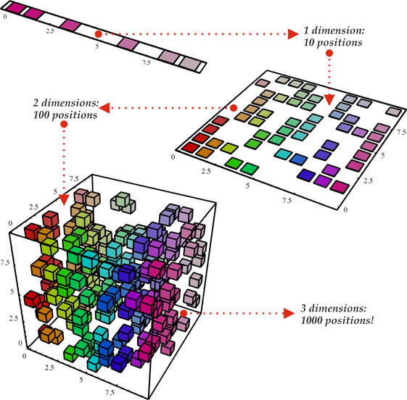
Why ML Is Hard The Curse Of Dimensionality
To generalize locally, you need representative examples from all relevant variations (and there are an exponential number of them)!
Classical Solution: Hope for a smooth enough target function, or make it smooth by handcrafting good features or kernels
Smooth?
(i). Space grows exponentially
(ii). Space is stretched, points
become equidistant

Slide 52
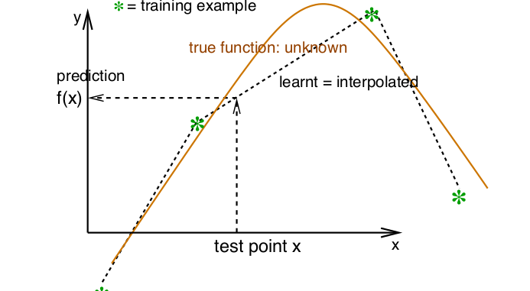
So What Is Smoothness?
Smoothness → If x is geometrically close to x’ then f(x) ≈ f(x’)

Slide 53
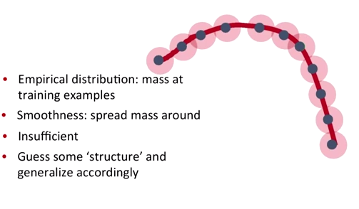
Smoothness, basically…
Probability mass P(Y=c|X;θ)
This is where the Manifold Hypothesis comes in…

Slide 54
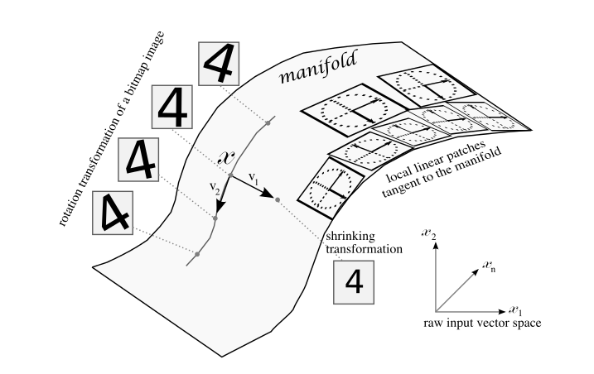
Manifold Hypothesis
BTW, you can demonstrate the MH to yourself
with a simple thought experiment on image data…
The Manifold Hypothesis states that natural data forms lower dimensional manifolds
in its embedding space. Why should this be? Well, it seems that there are both
theoretical and experimental reasons to suspect that the Manifold Hypothesis is true.
So if you believe that the MH is true, then the task of a machine learning classification
algorithm is fundamentally to separate a bunch of tangled up manifolds.

Slide 55
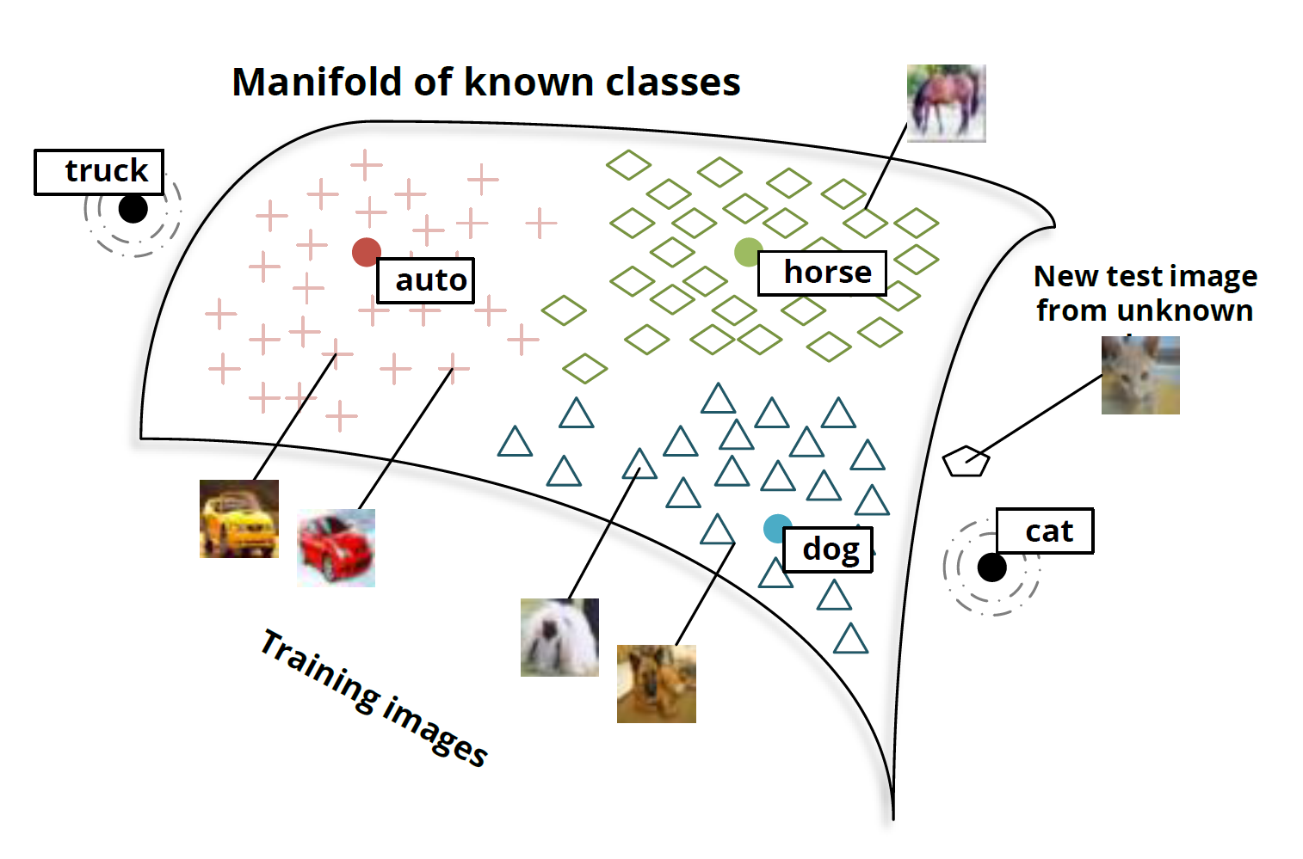
Another View: Manifolds and Classes

